Slide 1
Bootstrap 1: Intro to Responsive Design

Slide 2
Responsive Design
Prep Work
Finish all reading in HTML/CSS Duckett Books
Finish Portfolio and Landon Hotel Assignments and upload to the web server

Slide 3
Responsive Design
Today’s Topics:
Responsive Web Design Intro
Fixed Layouts
Flexible Layouts
Fluid layouts
Elastic Layouts
Responsive Layouts
Media Queries, Viewport and Breakpoints
Flexible Media

Slide 4
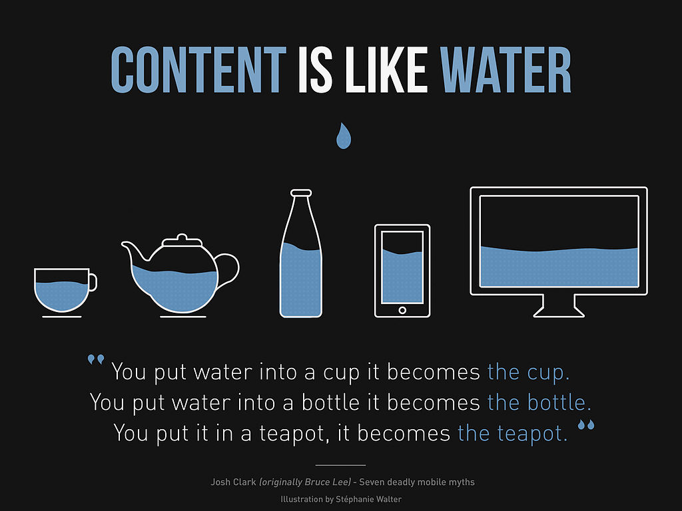
Responsive Design
Responsive Web Design:
The practice of building a website suitable to work on every device, or a design strategy that is centered on designing your content so that it responds to the environment it's encountered in.
Every screen size, no matter how large or small, mobile or desktop.

Slide 5
Responsive Design
Responsive Design was first coined by Ethan Marcotte who identifies three fundamental techniques for responsive design:
Fluid grids for flexible layouts
CSS media queries to help you adapt content to specific screen sizes (Small and XLarge not just handhelds)
Flexible images and media that respond to changes in screen sizes as well.

Slide 6
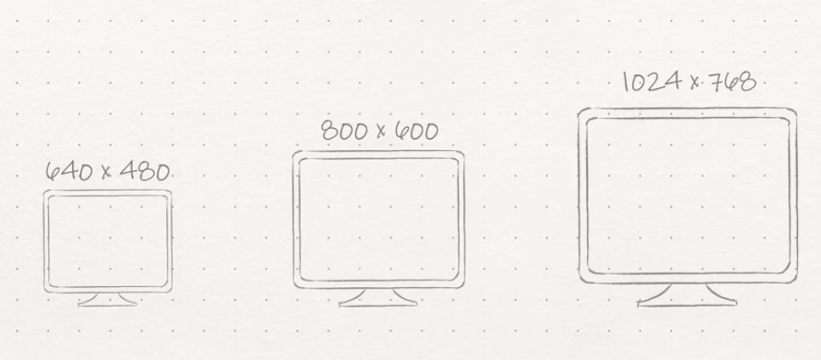
Responsive Design
Evolution of screen sizes:
We used to adapt design to new screen sizes
Made designs wider to accommodate bigger screens
Used Fixed Widths in our designs
Still common practice or standard layout to use fixed width in design

Slide 7
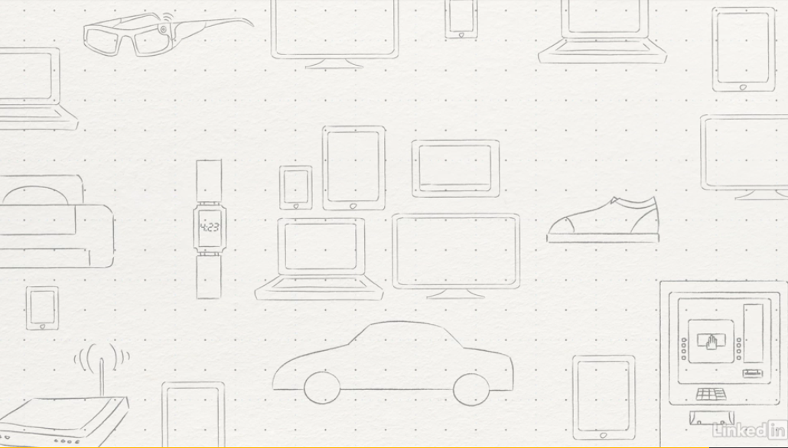
Responsive Design
With the evolution of device types the future of design is adaptive

Slide 8
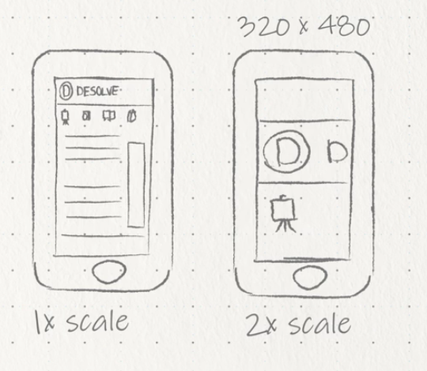
Responsive Design
What Makes Sites Responsive?
Clean well structured HTML
Planning and use of IDs and Classes

Slide 9
Responsive Design
4 Types of Layouts (there are others)
Fixed - doesn’t change regardless of device (2 column layout)
(fixed.html and fixed layout.html examples)
Fluid- responds as browser size or screen changes. Limited when really large or really small. (2 column layout fluid.html example)
Flexible/Responsive- responds to browser window, orientation and height of device. (3 column layout based on size flexiblelayout.html example)
Elastic (Based on ems) or Hybrid (all layouts mixed)

Slide 10
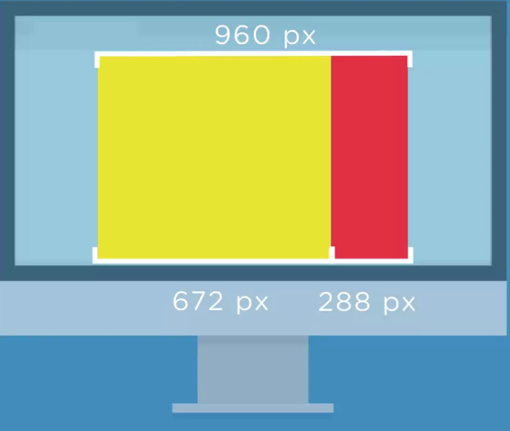
Responsive Design
Fixed - doesn’t change regardless of device (2 column layout by px)

Slide 11
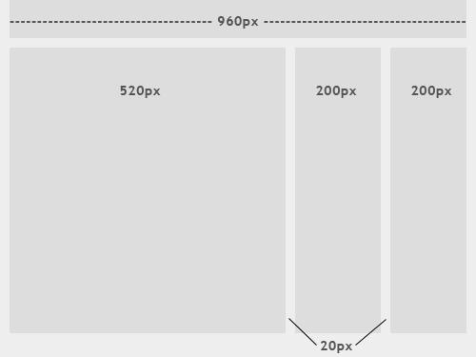
Responsive Design
Fixed Website Layouts Link
A fixed website layout has a wrapper that is a fixed width, and the components inside it have either percentage widths or fixed widths. The important thing is that the container (wrapper) element is set to not move. No matter what screen resolution the visitor has, he or she will see the same width as other visitors.

Slide 12
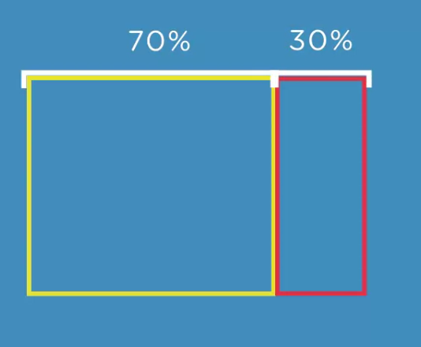
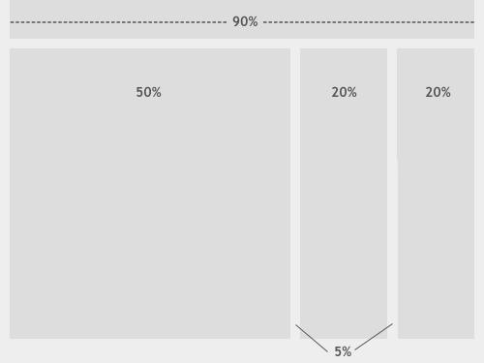
Responsive Design
Fluid/Flexible- responds as browser size or screen changes. Limited when really large or really small. (2 column layout by % stretches screen)

Slide 13
Responsive Design
Fixed Layout
PROs -
Doesn’t change regardless of device
Easy to create
Pixel precise consistent look and feel
CONs-
Don’t adapt to screen sizes
Can have horizontal scrolling and clipped content
Lot’s of extra space on larger monitors
Spacing issues

Slide 14
Responsive Design
Elastic Layout
What is an Elastic Layout?
An elastic layout scales with users’ text size.
More accurately, an elastic interface scales with browser text size—commonly a default of 16px—which users can change if they wish. Some people make a permanent change for accessibility reasons, others use the UI controls to increase text size if they need to.
Elastic design uses em values for all elements. Ems are a relative size, written like this: 1em, 0.5em, 1.5em etc. Ems can be specified to three decimal places like so: 1.063em.
If the user increases (or decreases) text size in their browser, the whole interface stretches (or shrinks.) (elastic.html example)

Slide 15
Responsive Design
Class Samples (same info just different css)
fixed.html -defined in the body as 960px
flexiblelayout.html - uses % on widths, padding on css elements
fluid.html - Uses % and adjusts size with screen
responsive.html - once it hits a breakpoint the layout changes 3 column-->2 Column-->1 Column as you resize
elastic.html - uses em and changes with browser text size

Slide 16
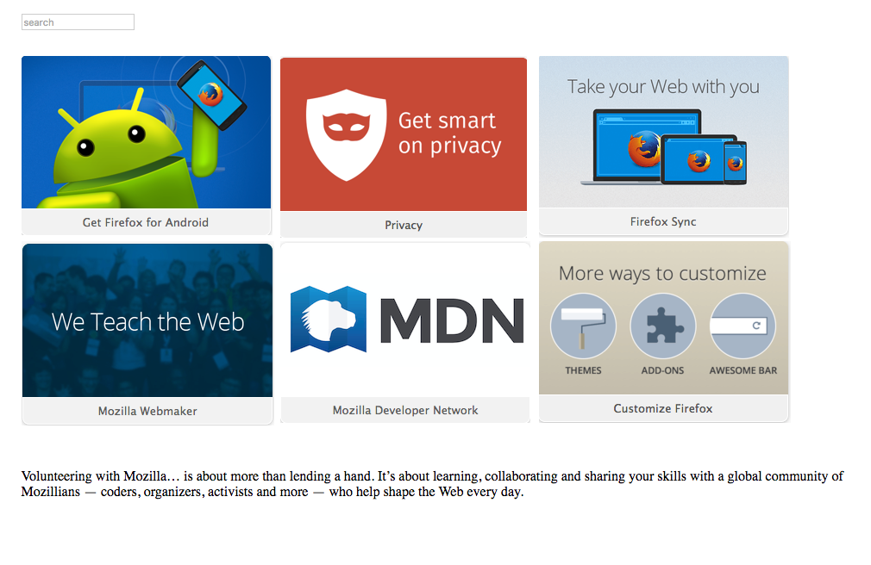
Responsive Design
Create a new HTML 5 page that looks like the following with a fixed layout (960px width)(instructor will send images: fixed-images.zip)
Save the html page to public_html/samples/fixedlayout.html
Save the css page to public_html/samples/fixedlayout.css

Slide 17
Responsive Design
Things to consider with responsive and flexible designs
Viewport (Both in HTML and CSS)
Zoom
Device Type
Screen Density

Slide 18
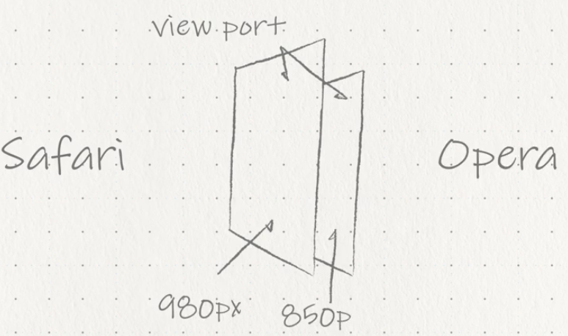
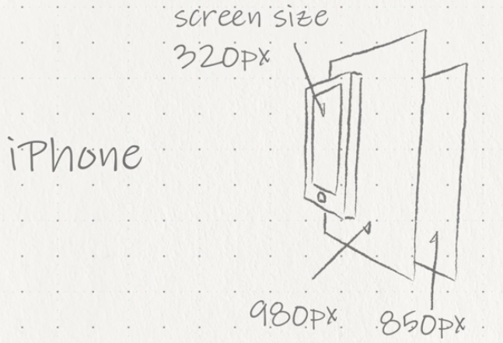
Responsive Design
Understanding the viewport
Area within the window of the browser/app independent of the screen
What happens to content as you zoom in and out
Designed to be larger than the screens resolution
Browsers will display a web page within the viewport and then shrink that viewport down until the content fits within the width of the screen itself. (Allows Zoom and to see the page entirely)
Browser VS Screen Size of iPhone

Slide 19
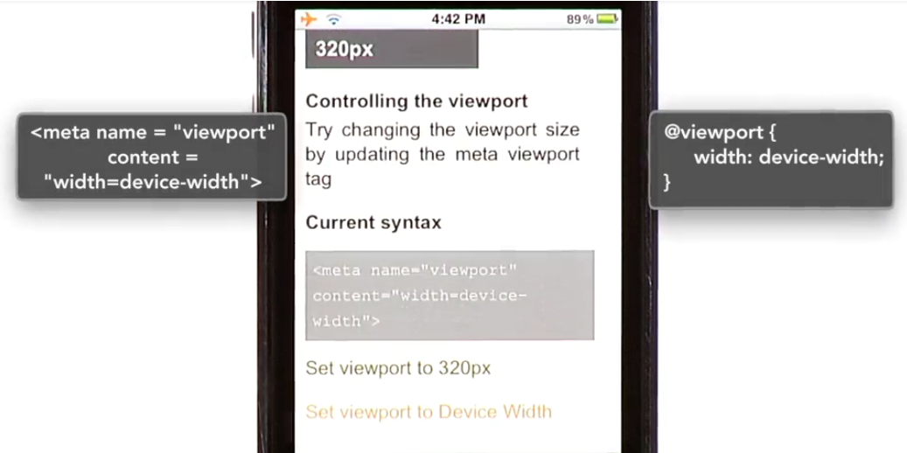
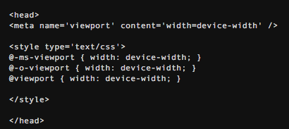
Responsive Design
Controlling Viewport
Used to respond on a phone or tablet to change sizes
Can use exact pixels but Device Width Scales to any device
2 Ways to add viewport (meta tag, @viewport)
Should use both Meta and @Viewport for browser supportability
Viewport Meta Tag (Goes in between <head></head>)
Uses -
Name- which is viewport
Content- which will contain the properties and values you wish to set for the viewport itself. (i.e device-width
@Viewport CSS -
Place at the top of your CSS before media query
Selector -@viewport
Declaration- width:device-width;
Limited Support

Slide 20
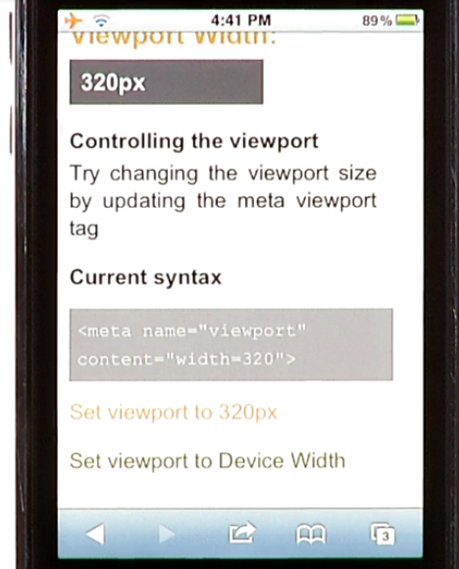
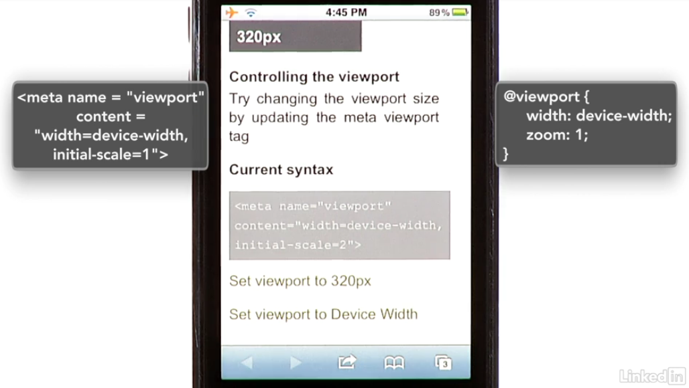
Responsive Design
Viewport and Scale Settings
No px needed in the meta tag if declaring width (fixed)
If using a fluid layout width=device-width set the viewport to the exact size as the available screen pixels. (Recommend Method)
device-height can be used also to but not often needed
initial-scale sets the viewport to the exact size as the available screen pixels. (1 is equal to 100% zoom) this is independent of viewport. Only used when you need to change zoom since default is 100% or 1. Can also set min and max zoom SYNTAX :<meta name="viewport" content="width=device-width" />

Slide 21
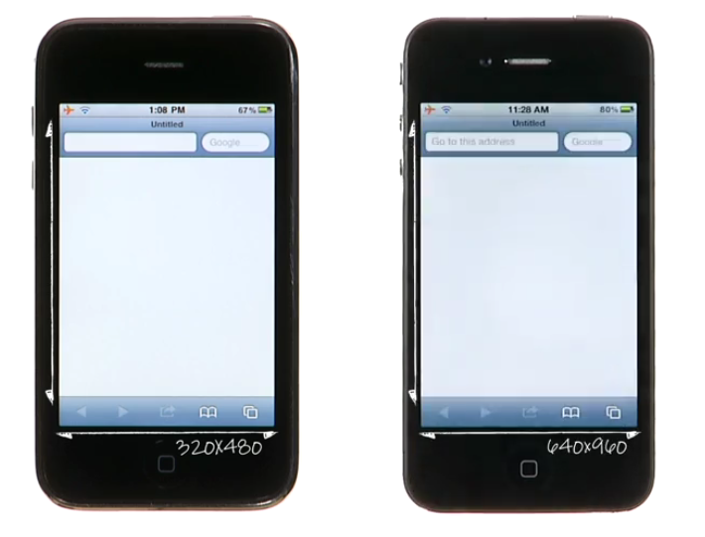
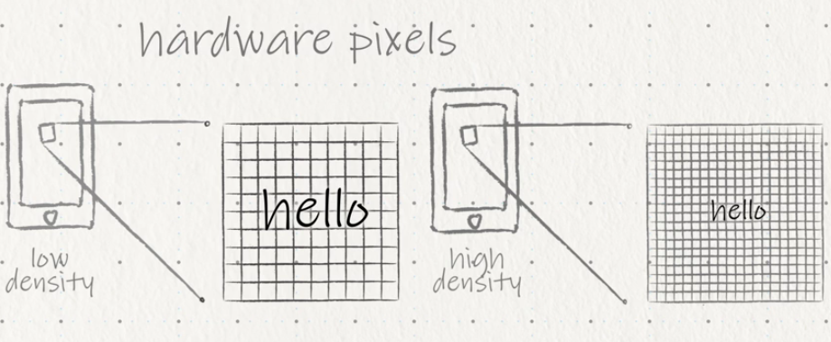
Responsive Design
Screen Density
Screen density is the number of pixels within a physical area of a screen sames screen size 3.5in
Newer screens are featuring higher and higher screen densities every year. A greater number of pixels
Same size screens uses hardware pixels instead of CSS based reference pixel
Text will look smaller so we will have to design for it
3G
4s
Example:
You had a line of text that was 30 pixels high on a lower-density screen. The same text mapped to the higher- density screen would now appear twice as small. That means without accounting for this difference, graphics and websites would appear dramatically smaller on newer higher-density displays.

Slide 22
Responsive Design
Design for Screen Density (Considerations)
Use more vector based graphics to reduce raster (can affect load time)
Can simply use high resolution images and anticipate the evolution of higher density screens that will display images
Must be concerned with data being used or downloaded
Can use Modern Pictograms, which are available at (Scale with text no quality issues)
https://www.fontsquirrel.com/fonts/list/find_fonts?q%5Bterm%5D=icons&q%5Bsearch_check%5D=Y

Slide 23
Responsive Design
Modify the fixed layout and make it flexible
Save fixedlayout.html as public_html/samples/flexiblelayout.html
Save the css page to public_html/samples/flexiblelayout.css
Add viewport Meta Tags to HTML and CSS and add % to width on all containers

Slide 24
Responsive Design
Media Queries
Provide the ability to specify different styles for individual browser and device circumstances.
Specify the width of the viewport or device orientation.
Media queries allow you to filter which styles are applied based upon the media query.
If these conditions are met, the styles contained within it are served.
If these conditions are not met, they are not served.
Uses Min and Max which will freeze layout if outside those sizes
Generally speaking it is recommend to use the @media rule inside of an existing stylesheet to avoid any additional HTTP requests.
Firefox has a nice built in tool to assist with sizing under Tools + Web Developer + Responsive Design Mode

Slide 25
Responsive Design
Common media types that can be defined
all
screen
print
tv
braille
3d-glasses (HTML5)

Slide 26
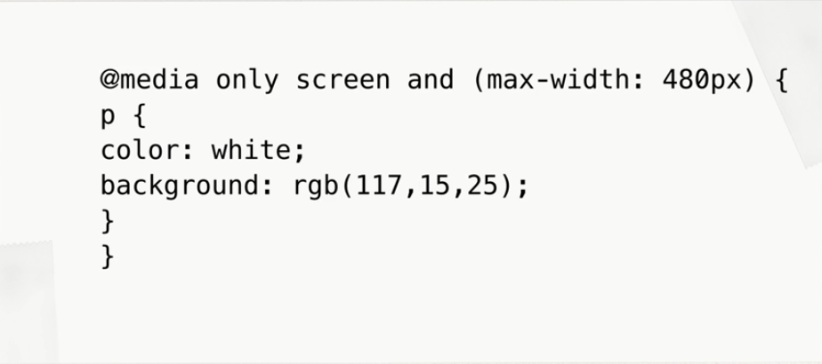
Responsive Design
Media Queries
Logical operators in media queries help build powerful expressions,and include and, not, all, and only. If no media type is declared “all” is the default.
In CSS Sheet: @media all and (min-width: 320px) and (max-width: 780px) {...}
In Style Link:
<link rel=“stylesheet” type=“text/css” href=“css/main.css” media=“screen and (min-width: 480px)”>
You can/should also apply media queries within the style sheets themselves. By using an @media block to surround styles, you can filter how styles within style sheets apply based on screen.

Slide 27
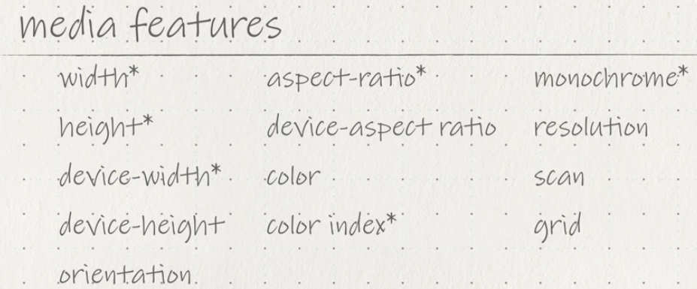
Responsive Design
Common media features

Slide 28
Responsive Design
Media Queries
Each media query may include a media type followed by one or more media types
@media only screen and (max-width: 480px)
Can also be placed in the CSS Style link and declare different css for each media type (i.e. change a font)
<link rel="stylesheet" type="text/css" media="screen" href="sans-serif.css"> <link rel="stylesheet" type="text/css" media="print" href="serif.css">
Full List: https://www.w3.org/TR/css3-mediaqueries/

Slide 29
Responsive Design
Media Queries
Within responsive design the most commonly used features include min-width and max-width.
These help build responsive websites on desktops and mobile devices equally, avoiding any confusion with device features.

Slide 30
Responsive Design
Media Queries
The orientation media feature determines if a device is in the landscape or portrait orientation.
@media all and (orientation: landscape) {...}
@media all and (orientation: portrait) {...}

Slide 31
Responsive Design
Creating Breakpoints with Media Queries
A breakpoint indicates the moment your layout switches from one layout/device to another, and is usually triggered by the width of a screen.
Breakpoints should only be introduced when a website starts to break, look weird, or the experience is being hampered.
(3 Basic /Most Common Break Points) The screen sizes are based on the typical screen sizes for smartphones, tablets, and desktop devices. These breakpoints should be defined for your layout

Slide 32
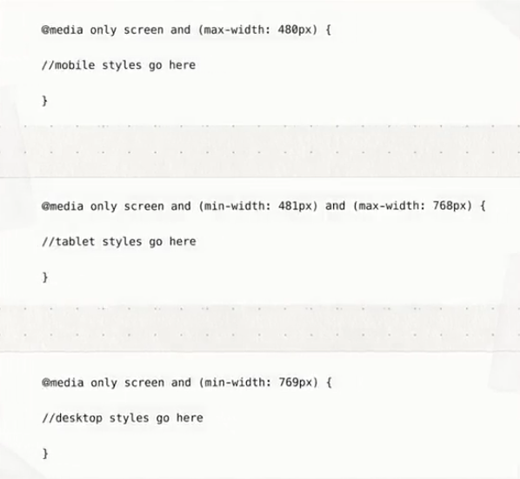
Responsive Design
(3 Basic /Common Break Points)
This can vary based on content

Slide 33
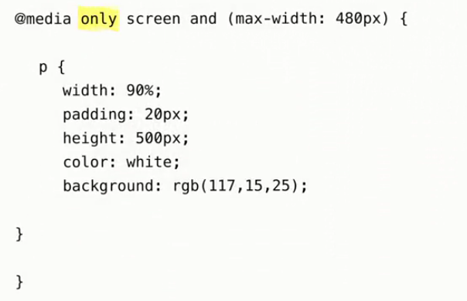
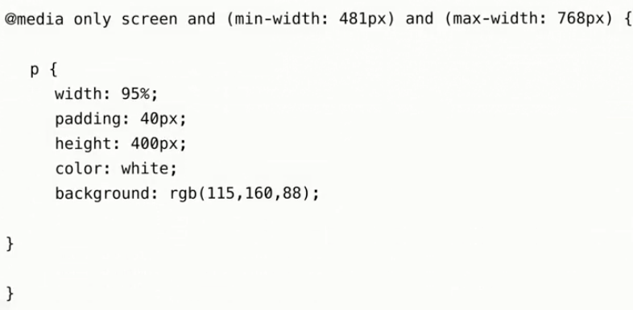
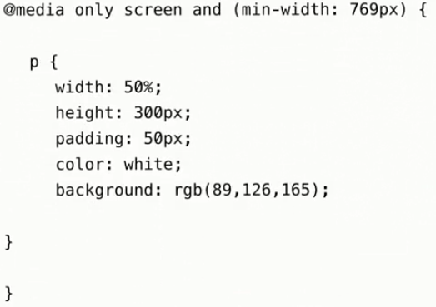
Responsive Design
Media Queries
Once you have your breakpoints, you'll need to then define your media queries to filter CSS style application based on your target sizes.
mobile media query
(EX: 3)basic-breakpoint.html - media queries that target sample breakpoints.
Note that each of the media queries uses the only keyword, which hide the styles from older non-conforming user agents.
Because of this, you will want to have a set of default CSS styles to fall back on.
The screen media types ensure that the styles apply to screen-based devices.
The mobile media query uses the maximum-width media property to restrict styles to screens under 481 pixels, which should target the majority of smartphone devices.
The tablet media query uses slightly longer syntax, by combining both a minimum and a maximum-width media property to define a specific range of screen sizes.
tablet media query
desktop media query

Slide 34
Responsive Design
Media Queries
NOTE: One quick way to make media/pictures scalable is by using the max-width property with a value of 100%
img, video, canvas {
max-width: 100%;
}
Creating breakpoints with media queries is an important part of responsive design, it's only the first step to creating responsive layouts.
To create a layout that's truly responsive, you'll need to combine these breakpoints with fluid grids.

Slide 35
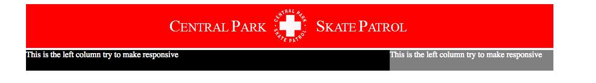
Responsive Design
Create the following page
Save as public_html/samples/breakpoint.html
Save the css page to public_html/samples/breakpoint.css
Add viewport Meta Tag to main page
Use <section> for columns and use a wrapper container div (max-width 1024px)
Set breakpoints for 1023, 640, and 320. Within those breakpoints, change the layout of the sections so you can see that the breakpoints worked.

Slide 36
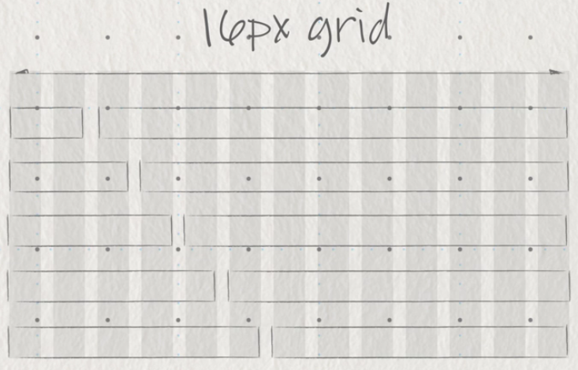
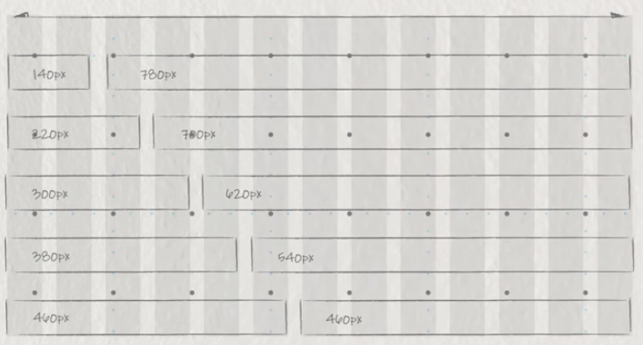
Responsive Design
Fluid Grids
Columns and base width is related to a default font size, ideal ratio, or an ideal screen width.
A 16-pixel-based grid is the default font size for most browsers,
The most popular currently is 920 pixels
Can have one design for each breakpoint. 920px

Slide 37
Responsive Design
Fluid Grids & Frameworks
Once you establish a grid you would use % or em values for the widths of columns to handle different screen sizes
You could construct the framework for the grids on your own but there are pre-set frameworks available
When designing you should set the width to a value slightly smaller than the target size to allow for things like browser chrome or maybe floating browser windows that aren't maximized (960 if fixed layout).
Framework Downsides
Heavily class based- using non semantic class names
Non semantic-Clutters your HTML
Extra clear elements -cause you to have to add code to HTML
Lots of extra unnecessary code and large in size

Slide 38
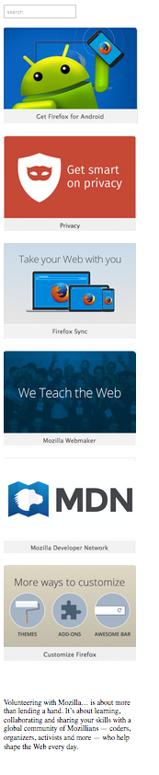
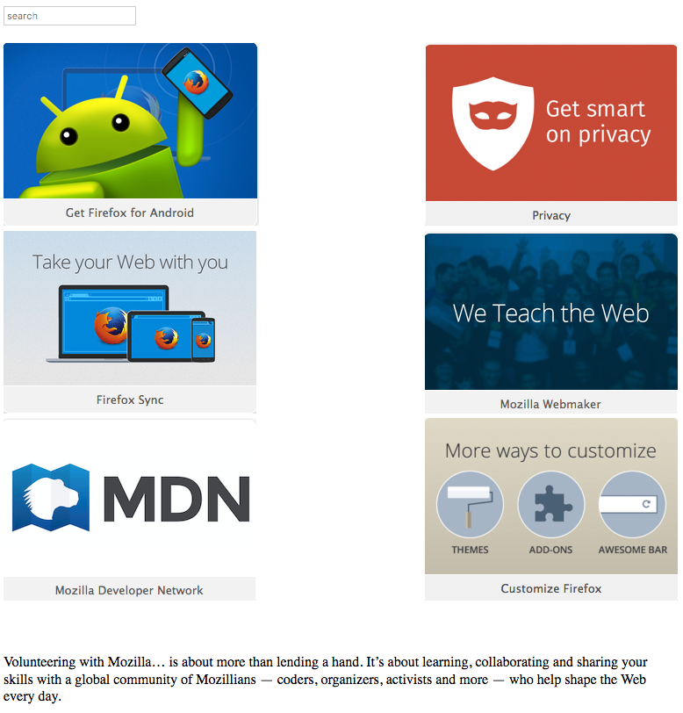
Responsive Design
Modify the flexible layout and make it responsive
Save flexiblelayout.html as public_html/samples/responsivelayout.html
Save the css page to public_html/samples/responsivelayout.css
Add @Media Breakpoints (hint: 959px and 774px) to collapse images
At 959px
At 774px

Slide 39
Responsive Design
Responsive Images Can Be Coded In a Couple Ways (also for video)
Replace the fixed width on the image to %
<img src=“images/image.png” width=“100%” height=“300” />
Use a max-width in CSS to keep it from scaling
Create an image container and set the max-width to the container
img {max-width:100%;}
Could create 3 separate images and/or containers to help with file size and place as a background image in the container for mobile devices
Can also use hidden in block element to hide on smaller screens
Issues:
Max-width not supported by I.E.
Using the largest image size that your layouts might require, causes file size to be large and slower download
Using images as background url can only be used if it is not needed in HTML

Slide 40
Responsive Design
Additional Terminology
Responsive - React quickly and positively to any change
Adaptive - means to be easily modified for a new purpose or situation, such as change. Adapts but snaps based on breaks. Responsive layouts are smoot
Helpful Links-
http://www.liquidapsive.com/
http://codepen.io/shayhowe/pen/zhAsj
http://learn.shayhowe.com/advanced-html-css/responsive-web-design/
https://css-tricks.com/the-difference-between-responsive-and-adaptive-design/

Slide 41
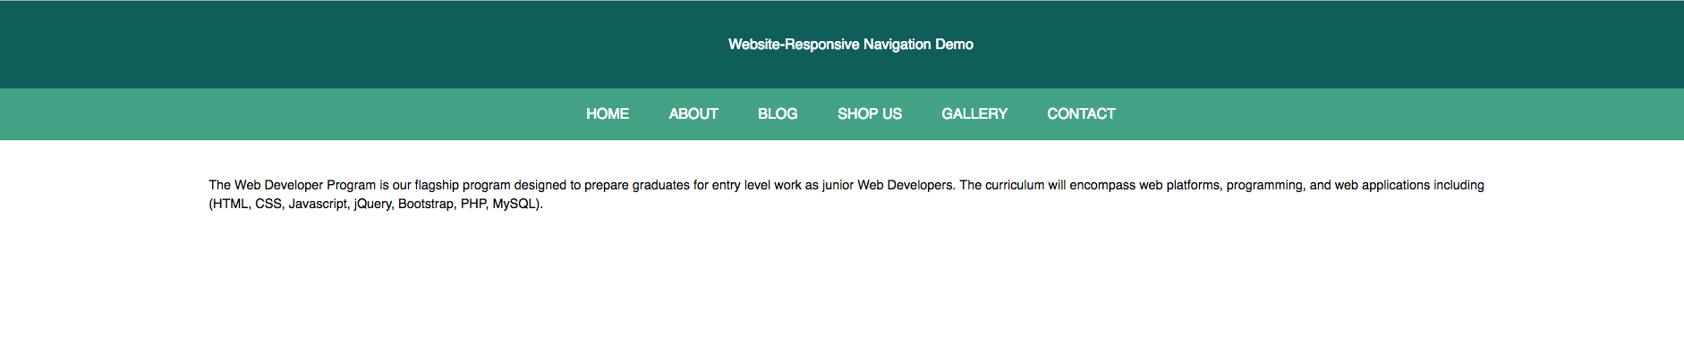
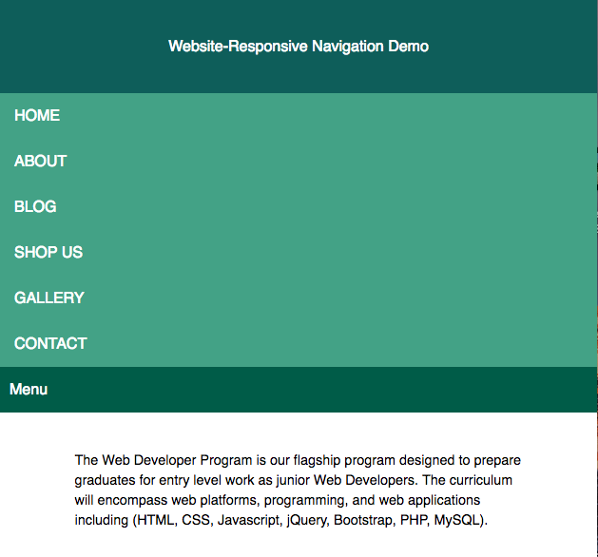
Responsive Design
Create a Responsive Navigation that looks like this (Time Permitting)
Create a new file public_html/samples/navbar-responsive.html
Save the css page to public_html/samples/navbar-responsive.css
Add the text from instructor and modify the CSS

Slide 42
Responsive Design
Homework
Complete responsive assignments, upload them to the web server public_html/samples folder and email a link to the instructor
Practice Responsive layouts and breakpoints
Begin Treehouse, Responsive Layouts [47 min]
https://teamtreehouse.com/library/responsive-layouts
Begin Treehouse, Framework Basics [463 min] https://teamtreehouse.com/library/framework-basics

Slide 43
Responsive Design
END

